Slide 1
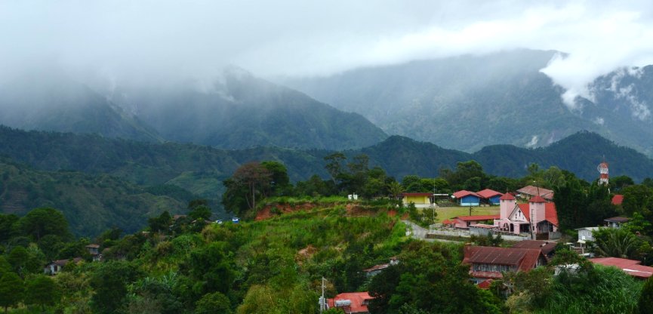
Enhancing Inter-LGU Cooperation in
Improving Maternal and Child Health Services in the Cordilleras
Department of Health (DOH)
Japan International Cooperation Agency (JICA)
System Science Consultants, Inc. (SSC)
Notes:
TWO major topics / characteristics of the Project -- differences from other MCH projects
Inter LGU cooperation for continuous MCH services
In the mountainous areas where Indigenous Population shares the majority

Slide 2
Why does Cordillera need to improve
Maternal and Child Health services?
Facility-based delivery (FBD) and health check-ups
  key strategy to reduce maternal deaths
Wide urban/rural disparities in the Cordillera
  FBD rate: urban areas 80-100% vs. rural areas 30-50%
Rural areas in CAR:
  limited health resources
  financial barriers
  70% Cordillerans: Indigenous People (IP)
Key project interventions
  Upgrade 61 BHSs, 19 RHUs, 14 hospitals in rural areas
  Increase PhilHealth coverage among the poor and the IPs
  IP culture friendly maternal care and promotion
Notes:
Notes:
Rural areasの3つのBulletsと
Project Interventionの3つのBulletsを
対応させてあります。

Slide 3
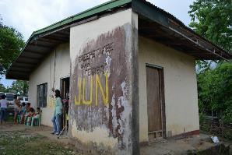
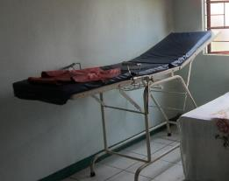
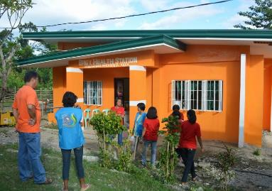
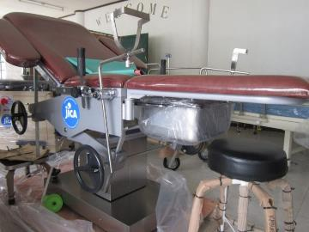
Upgrade birthing facilities in rural areas
Easy access to quality birthing facilities in far-flung barangays
Notes:
(サラッと流す：下記は説明しない。補足資料)
Upgraded 14 primary hospitals, 19 Rural Health Units, and 61 Barangay Health Stations
Trained more than 300 doctors, nurses and midwives on basic emergency obstetric and newborn care (BEmONC)

Slide 4
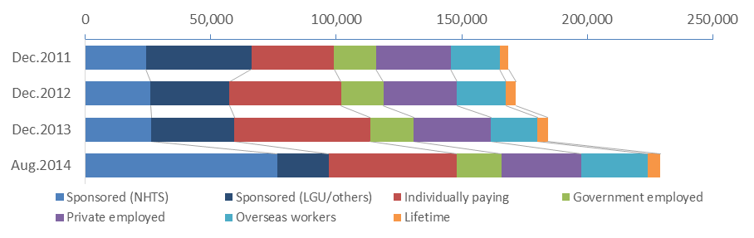
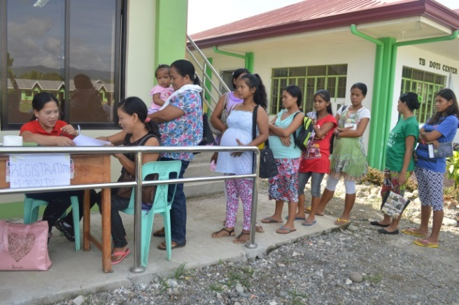
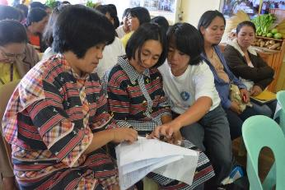
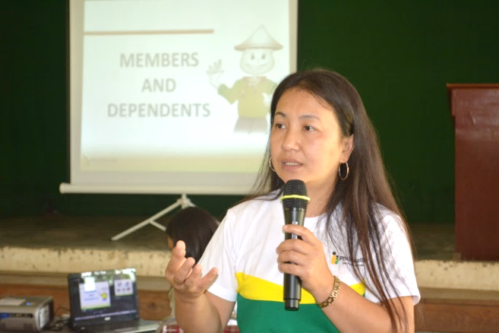
Increase population coverage of
National Health Insurance Program
Especially targeted to the Poor and Indigenous People (IP)
Notes:
(サラッと流す：下記は説明しない。補足資料)
Coverage among the Poor [blue and dark blue 1st and 2nd groups]: 50% increase in 3 years (2011-2014)
Expanded coverage especially thru NHTS plus
Advocacy to local chief executives to enroll non-NHTS covered poor
Coverage among Informal sector (farmers, self-employment) [Red: 3rd group]: 55% increase
Enrollment campaign especially targeted pregnant women
Municipal legislation to require PhilHealth membership for marriage certificate

Slide 5
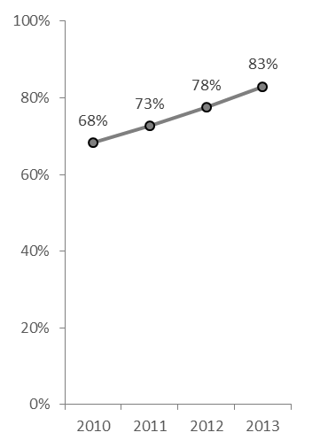
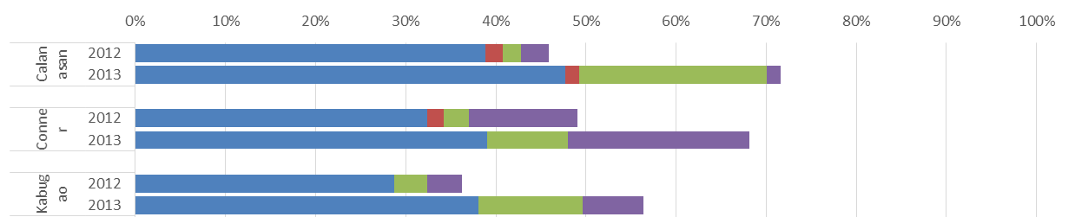
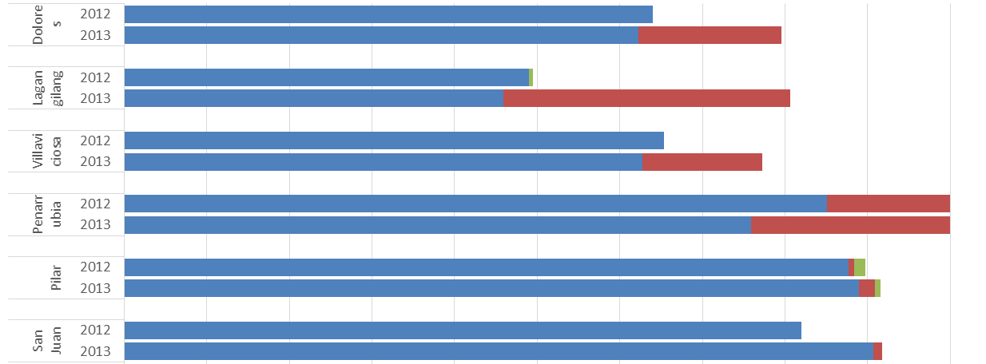
Impact of the Project
Increased facility-based deliveries (FBD) in rural areas
Regional FBD rate-CAR
Municipal FBD rate 2012 & 2013 (exemplary municipalities)
Continuous increase of region-wide facility-based delivery (FBD) rate
Increased facility-based delivery especially in rural areas
  Mountainous rural areas: increase in Barangay Health Stations (green)
  Flat terrain rural areas: increase in Rural Health Units (red)
Notes:
(サラッと流す)

Slide 6
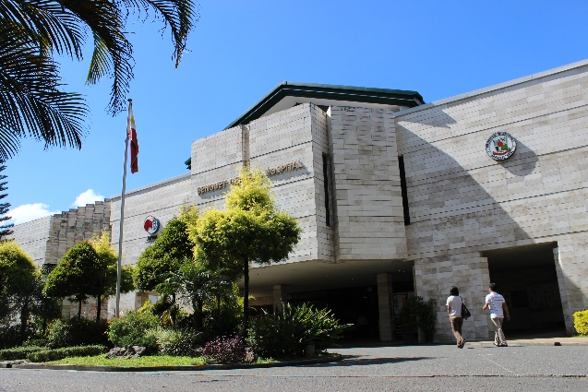
Continuous care thru health facility network
No single health facility can provide all services for mothers
especially in rural areas.
Prenatal Care: BHS
Delivery: RHU
Post partum care: BHS
DECENTRALIZATION
Emergency: Prov. Hospital
Notes:
Urban areas: One hospital can provide all care continuously
Rural areas: Geographical barrier | no easy access to a hospital in urban area. Prefer to go BHS in neighborhood
Decentralization / Devolution in 1991 fragmented network especially between MUNICIPAL health facilities (RHU, BHS) and PROVINCIAL Hospital

Slide 7
Inter LGU cooperation for continuous services for mothers
Inter-local health zone (ILHZ)
  provincial hospital
  municipal health centers
  barangay health stations
  private clinics
  local chief executives
Activities of ILHZ
  smooth patient referral across
  LGU boundary (hospital – RHU/BHS)
  human resource sharing
  ambulance sharing
  Incentives for health volunteers
Clinic
BHS
RHU
RHU
RHU
Prov. Hospital
BHS
BHS
Notes:
Notes:
Incentive for health volunteers:
Health volunteer benefits both municipal and provincial health service providers. Thus, CHT incentive is better to be co-funded by Municipal and Provincial LGUs.
For example, municipal LGU provide PhilHealth sponsorship to a poor pregnant woman.
If she delivers at Provincial hospital, all PhilHealth reimbursement goes to Provincial hospital, though it is municipal LGU who pays premium. It is not fair.
Thus, in DOLASAN ILHZ, Abra, ILHZ-CHTF, to which both provincial and municipal LGUs make contributions, pays financial incentive to a health volunteer who accompany to such a women, so that provincial government pays some part of CHT incentive.

Slide 8
Project Interventions to facilitate inter LGU cooperation thru ILHZ
Develop Local Health Systems manual based on Benguet’s ILHZ and Common Health Trust Fund (CHTF) experience
Orientation to Local Chief Executives and
Health Workers on ILHZ, CHTF and referral system
Develop and Implement ILHZ MNCHN referral manual/guideline
Integrate Barangay MNCHN Emergency Plan into Barangay Disaster Risk Reduction Management (BDRRM) Plan of DILG
Notes:
Notes:
DILG mandates all barangays in the country to develop BRRRM plan to define how to provide emergency transportation to vulnerable groups including pregnant women and newborns during disaster.
The Project expand the application of the BDRRM plan (i.e. utilization of community-based emergency transportation system) into non-disaster setting, naming the extended plan as Barangay MNCHN Emergency Plan.
Community-based emergency transportation includes contracting tricycle drivers, geepney, hammock team.
Budget for implementation of the Plans (BDRRM plan and MNCHN emergency plan) is provided thru IRA (internal revenue allotment) paid to Barangay.

Slide 9
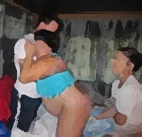
Respecting culture of indigenous people when maternal care is provided
IP culture friendly services
  squatting position
  attendance of husband
  burying placenta in home yard
Peer education thru
community health volunteers
  health check-ups during pregnancy
  PhilHealth enrollment
  facility-based delivery
  health check-ups after delivery

Slide 10
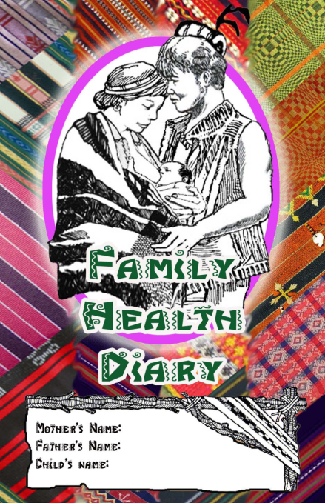
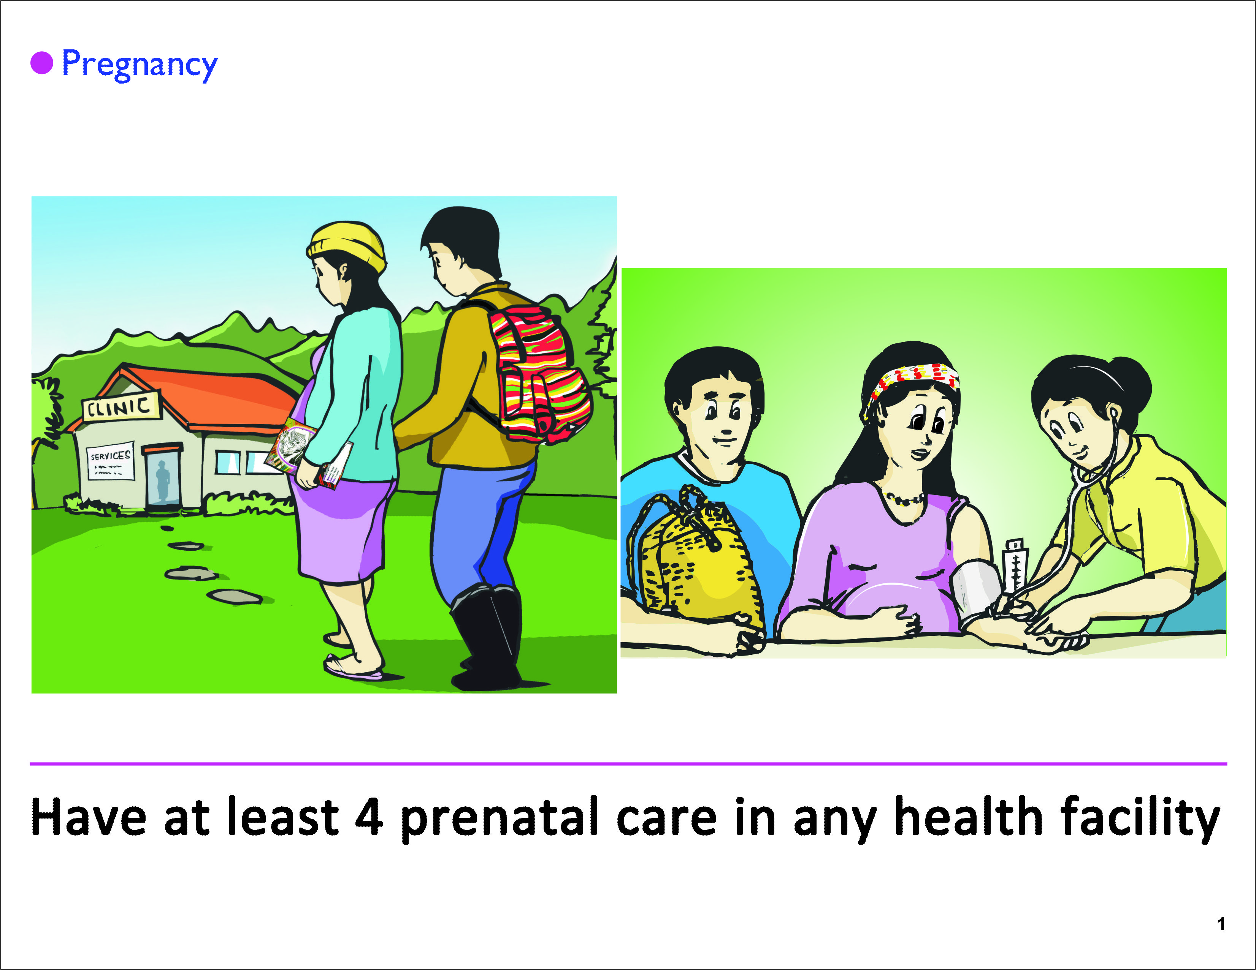
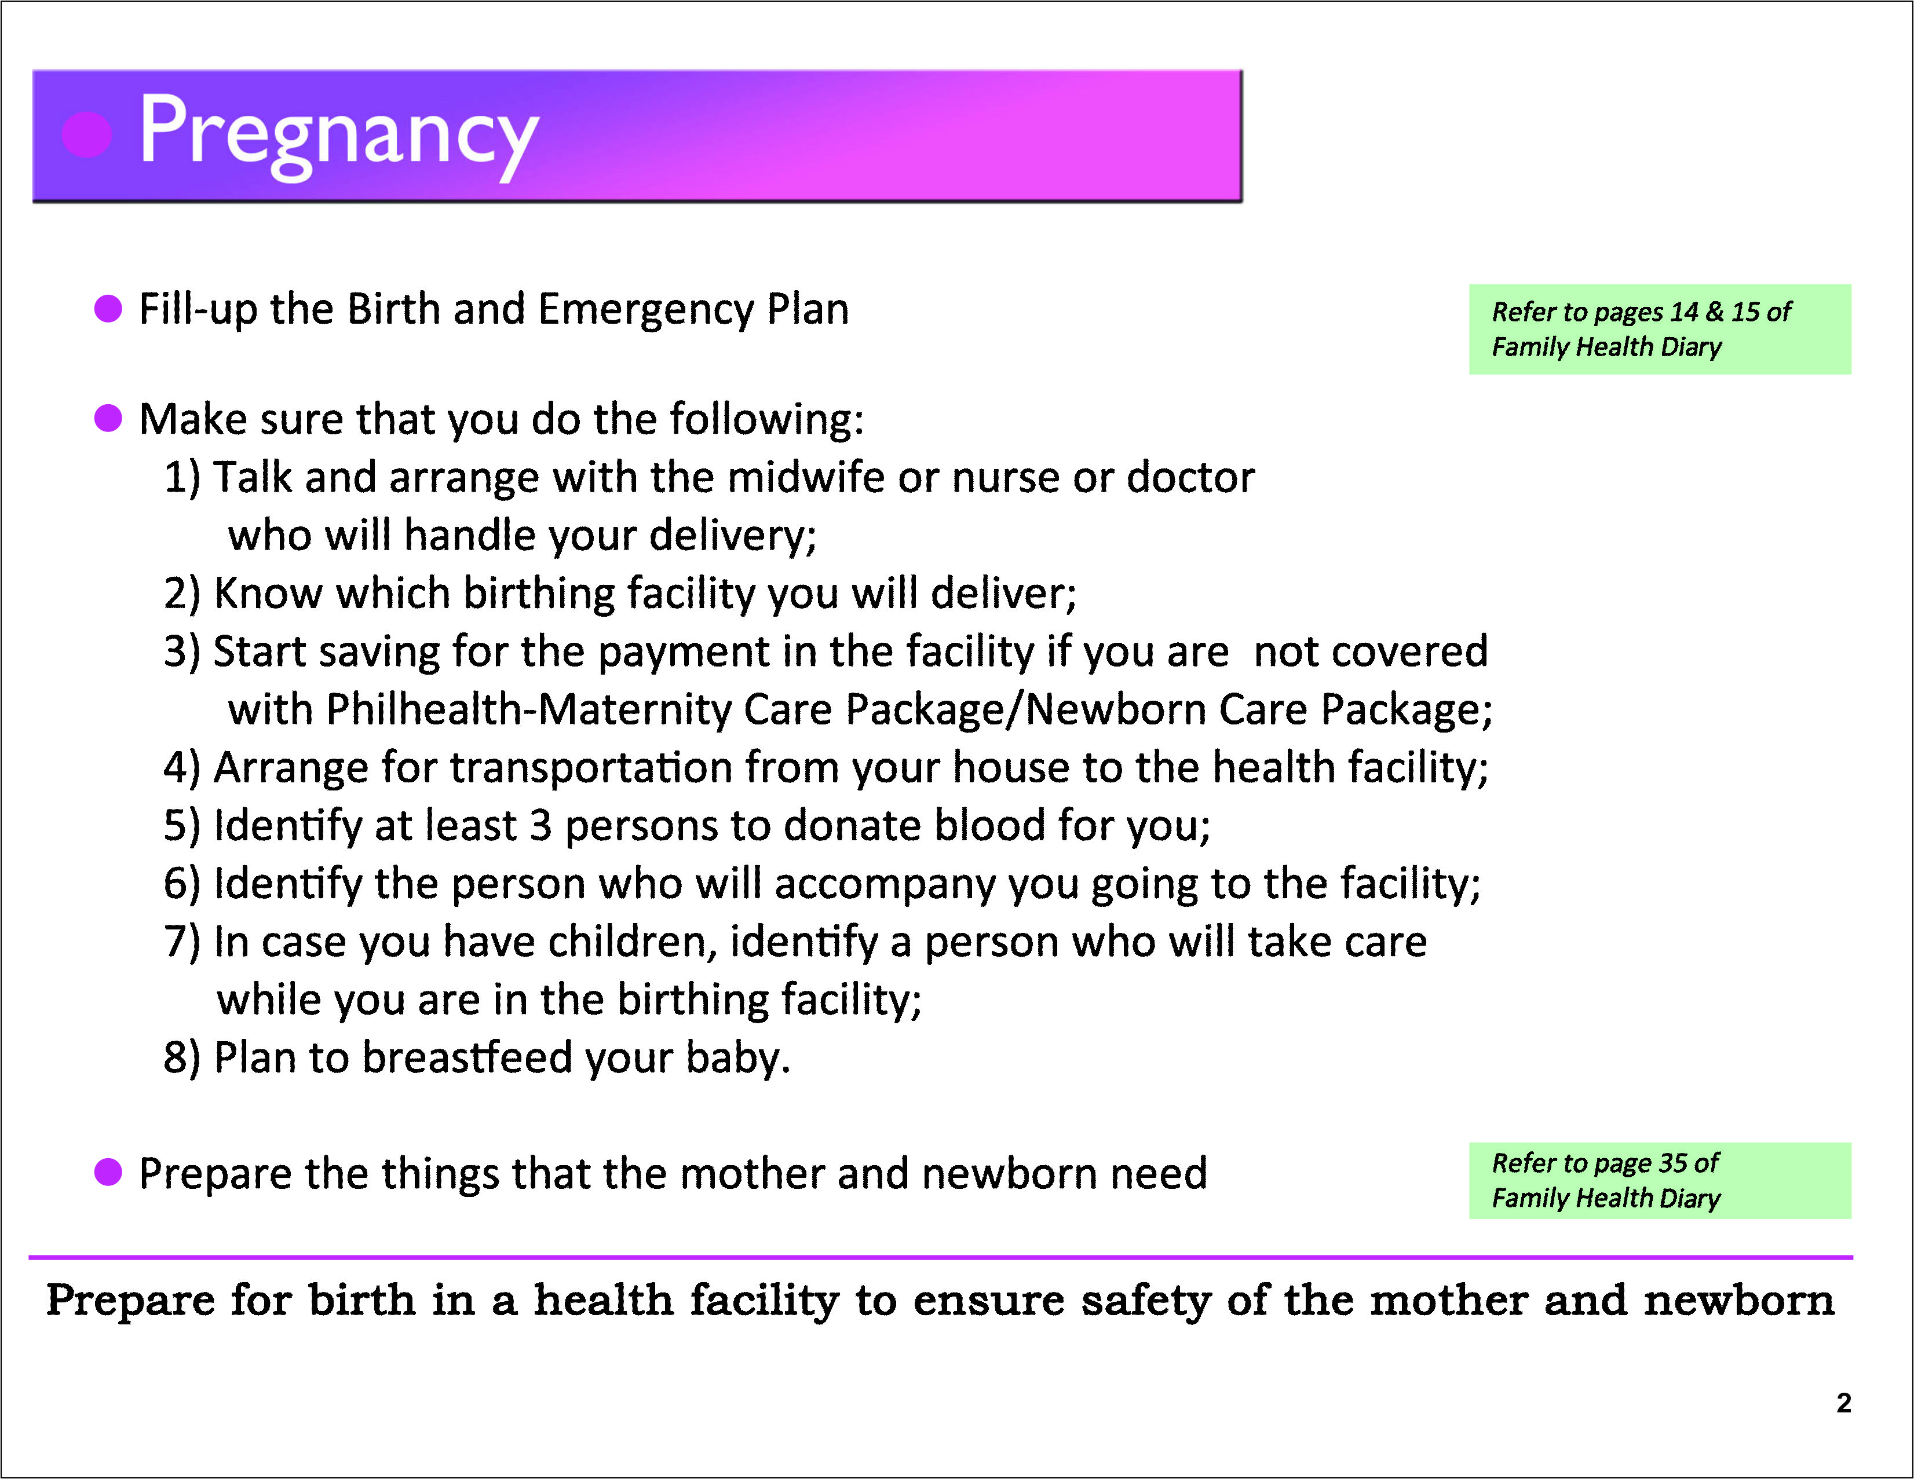
Project Interventions to provide IP culture friendly services
Localize MNCHN Manual of Operations to CAR
Develop IP friendly MNCHN IEC materials for Community Health Teams (CHT)
Notes:
Localized MNCHN Manual: Point of Localization (what is not included / emphasized in original (national) version)
Inter Local Health Zone (ILHZ) as a basis for establishment of MNCHN Service Delivery Network and for improve referral system
Respect pregnancy/delivery-related Indigenous People’s culture
Emphasis of role of CHT as communicators and use of Family Health Diary
Upgrading BHS as birthing facilities

Slide 11
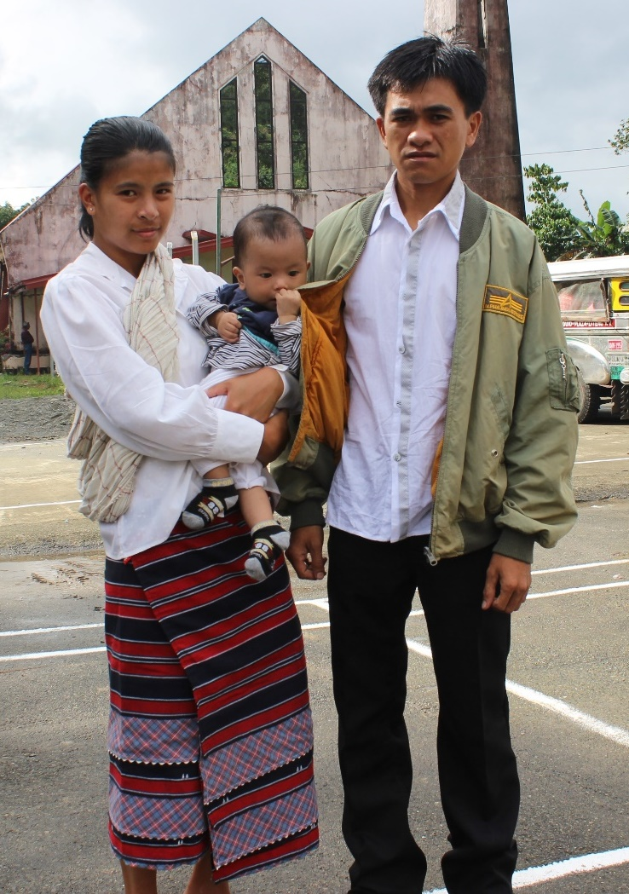
“In previous pregnancy, I delivered at home.
But this time, I preferred to deliver at
Barangay Health Station, because…”
it is near and accessible
it is clean and well equipped
midwife allows me to bring back placenta to my home, respecting my cultural preference
midwife is reliable and responsible
mayor provides free transportation, diaper and even cash incentive
I have no worry on medical expenses because I am a PhilHealth member

Slide 12
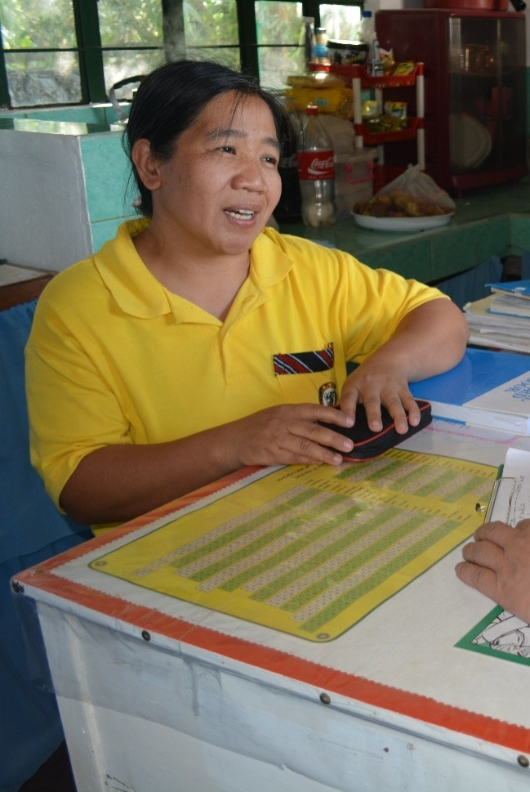
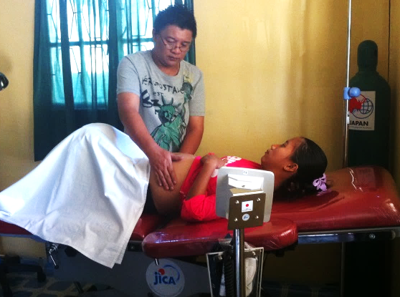
“I became more confident in providing birthing services at my barangay health station, because…”
I can refer a patient to a hospital in inter-local health zone in case of complications
Barangay provides patient transportation in case of emergency
I am trained on latest emergency obstetric care (BEmONC)
My facility was renovated and is well equipped
CHTs are more active
I can improve my facility using PhilHealth MCP reimbursement
DOH-rep and provincial health officers regularly monitor and provide technical support
Notes:
時間がない場合はこのスライド自体、飛ばしてもいいと思います。
本編と関連性の高い順に並べてありますので、特に下の方のBulletsは省略してかまいません。

Slide 13

Thank you! Any questions?
Department of Health
Bureau of International Health Cooperation
San Lazaro Compound, Rizal Ave.
Sta. Cruz, Manila, Philippines
Tel: 02-651-7800
JICA Philippine Office
40th Fl. Yuchengco Tower, RCBC Plaza
6819 Ayala Avenue, Makati City
Tel: 02-889-7119
JICA-SSC Project Office
Cordillera Administrative Regional Office
Department of Health (DOH-CARO)
BGHMC compound, Baguio City, Philippines
Tel/Fax: 047-422-0239

