Slide 1
strategy FOR improving quality of data on maternal and child health and family planning
2014 NEDA Good Practice Awards
December 8, 2014

Slide 2
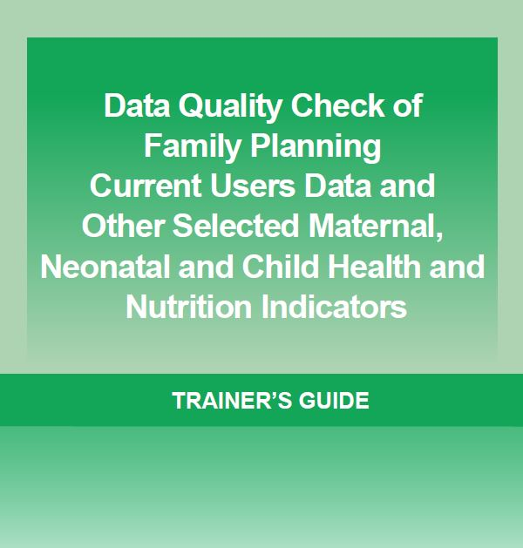
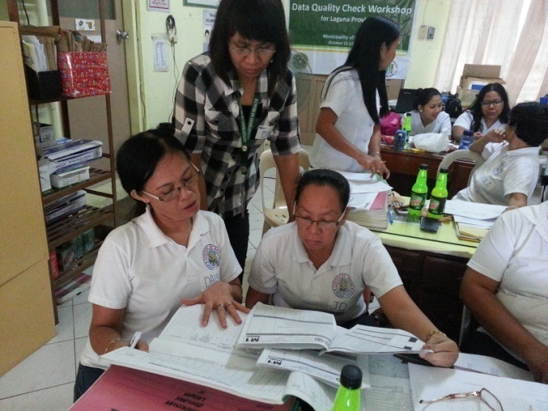
What is “data quality check” (DQC)?
Through a self-assessment tool, a systematic “check” to ensure that that the FHSIS indicator definition, formula for computation, and recording and reporting processes have been correctly applied
Major features:
Complete check on all records and reports of all midwives and nurses not just on sample
Check recording and reporting of actual data at source, i.e., TCL
Check against common set of guidelines to ensure consistency across data checks
Current FHSIS indicator coverage: FP current users, ANC4, SBA, FBD, FIC, EBF and Vitamin A supplementation
Notes:
What is “data quality check” (DQC)?
Through a self-assessment tool, a systematic “check” to ensure that that the FHSIS indicator definition, formula for computation, and recording and reporting processes as contained in the DOH FHSIS Manual of Operations have been correctly applied
Currently, FHSIS indicator coverage of DQC are the FP and MCH indicators: FP current users, ANC4, SBA, FBD, FIC, EBF and Vitamin A supplementation
In field application, such process has helped uncover various sources of inaccurate reports. These include:
not all services were recorded in the FHSIS recording tools;
the Target Client List (TCL) is not updated;
services are not recorded properly according to the procedures for accomplishing the TCL (e.g., in defining the eligible population, rules for determining drop outs); and
recording of services did not follow the definition and formula for estimating service utilization
DQC provides a systematic approach for identifying and addressing these sources of inaccuracies in key FP and MCH indicators in FHSIS, and in the process for identifying areas for improving service delivery.

Slide 3
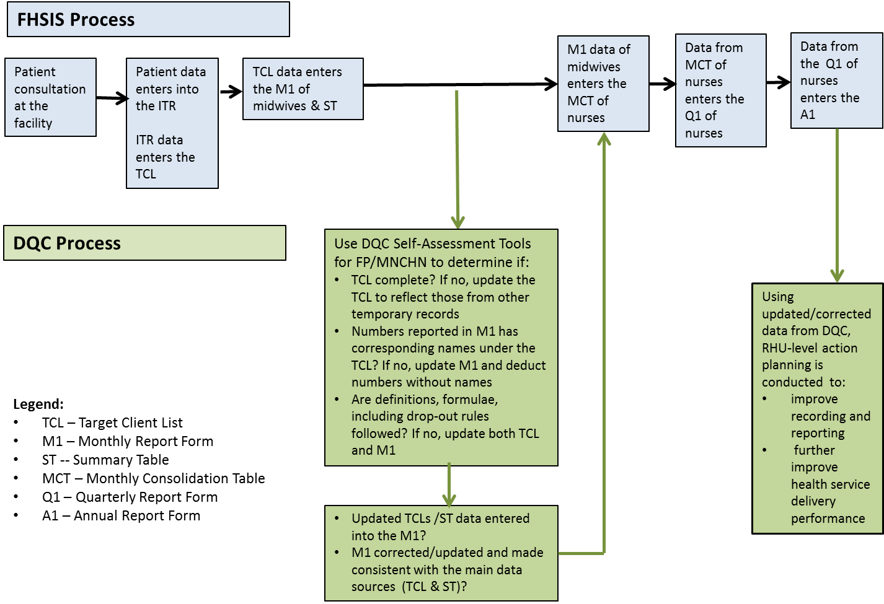
The DQC Process vis-à-vis the FHSIS Process
Notes:
This diagram shows the DQC process → that shows how data are reviewed / validated / and corrected before it reaches the reporting forms that will go all the way from the barangay level to the municipal /city level to the provincial level and consolidated up to the regional level and the national level
Using updated/corrected data from DQC, RHU-level action planning is conducted to:
Improve recording and reporting
Further improve health service performance

Slide 4
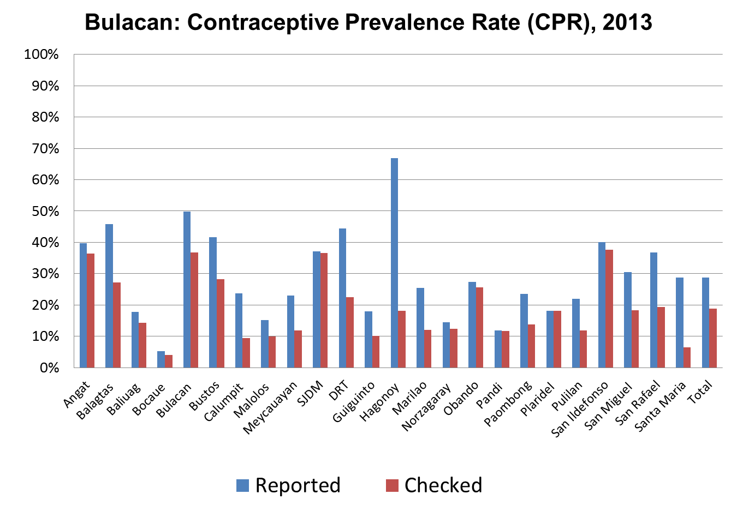
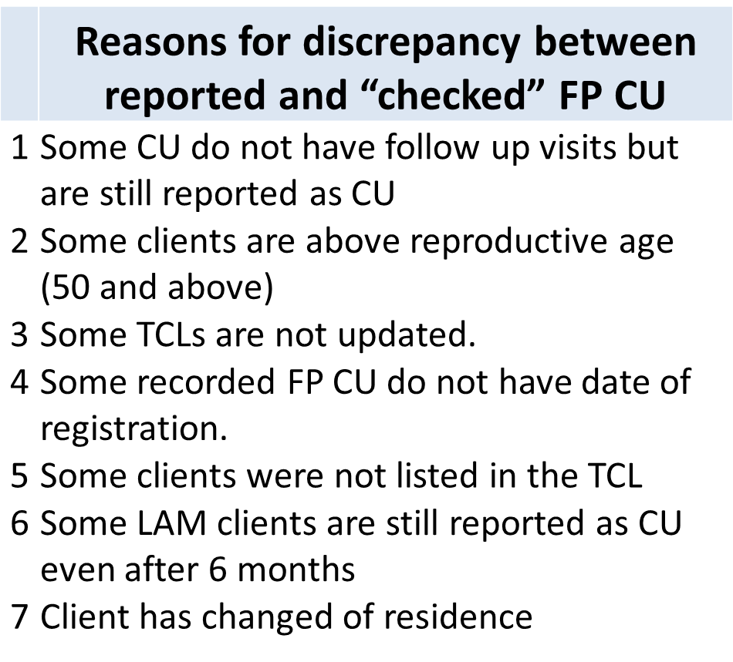
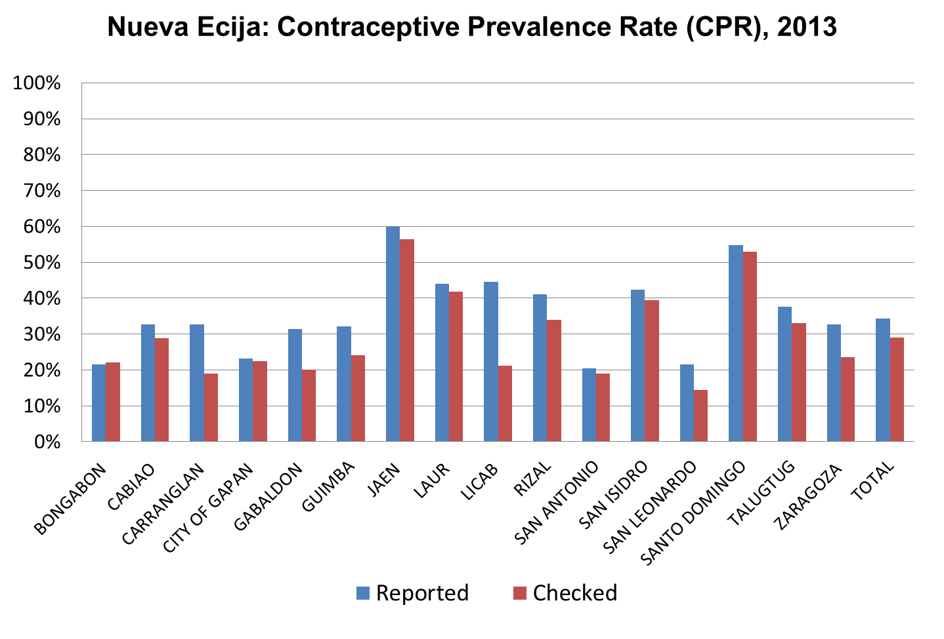
Examples of reported and CHECKED data
Notes:
Shown here are the some of the results of DQC activities conducted in provinces of Bulacan and Nueva Ecija:
Results shows that:
Some current users do not have follow up visits but are still reported as CU
Some clients are above reproductive age (50 and above
Some TCLs are not updated
Some reports have numbers with no names from the data source
Some recorded FPCU do not have date of registration
Some clients were not listed in the TCL
Some LAM clients are still reported as CU even after 6 months
Some clients have changed residents and have not been seen for years and still being reported
And these are findings from the midwives’ DQC activities; they themselves decided to correct their own data

Slide 5
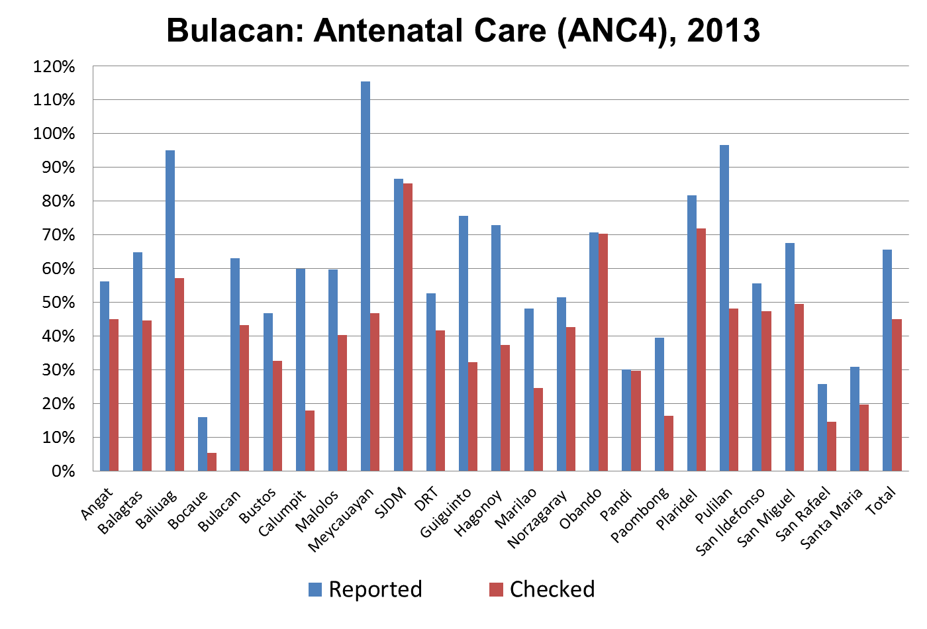
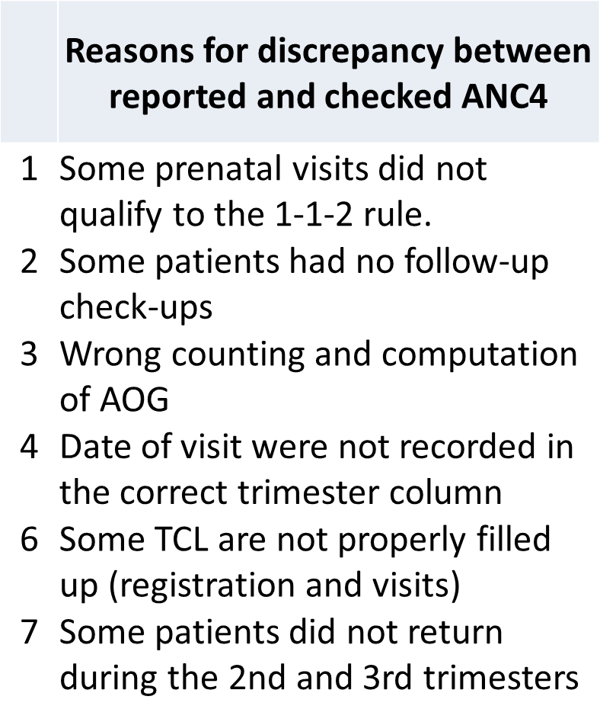
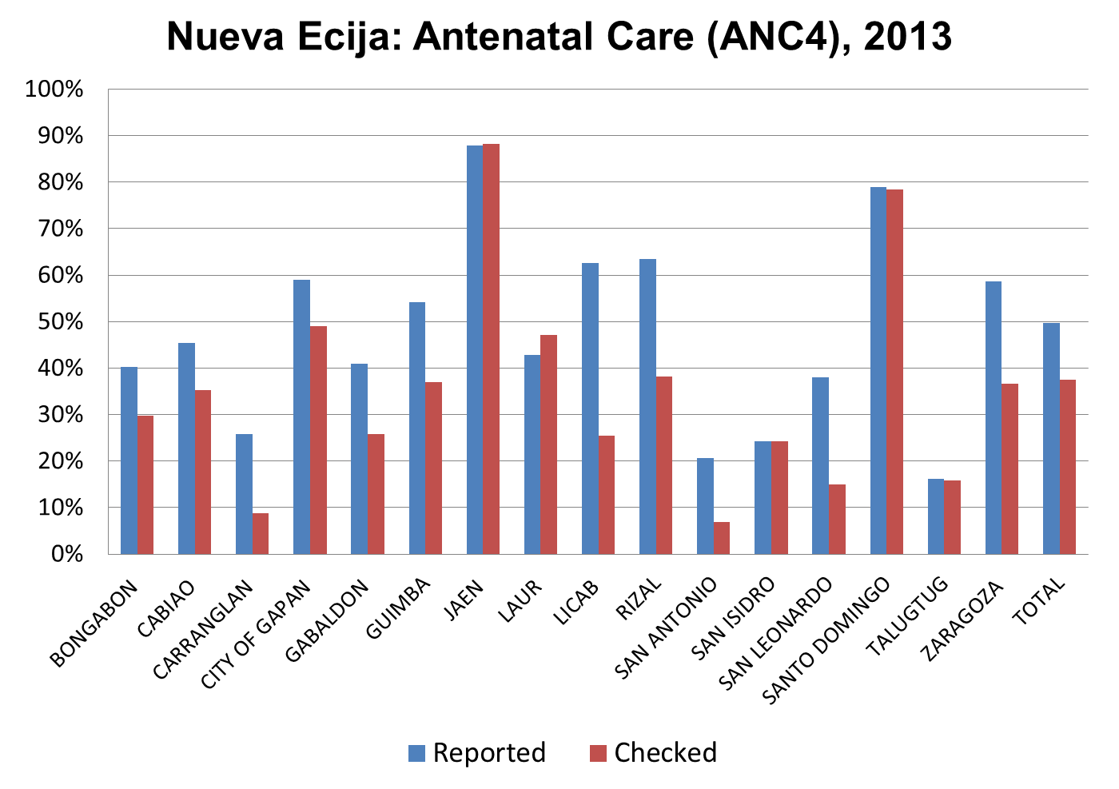
Examples of reported and CHECKED data
Notes:
While results for the DQC of antenatal care 4 (ANC4) shows the following sources of discrepancies:
Some pre-natal visits did not qualify for the 1-1-2 rule
Some patients had no follow-up check-ups but still recorded under this indicators
Wrong counting and computation of the age of gestation
Date of visits were incorrectly recorded in the correct trimester column
Some TCLs are not properly filled-up
6. Some patients did not return during the 2nd and 3rd trimesters

Slide 6
Improving Data Quality and Service Delivery
Common sources of discrepancy in recording and reporting related to service delivery | Service delivery improvements
Family planning current users (FPCU)– no follow-up of clients but still reported as current users contrary to guidelines | Identify clients for follow-up to determine what services needed at the same time update data on current users
Antenatal care (ANC4) – clients reported as ANC4 even if rule of 1-1-2 visits not followed; no follow-up on clients who did not return for additional visits | Improve communication outreach to get pregnant women early for prenatal; improve quality of prenatal service to encourage regular visits
Skilled birth attendance (SBA) – births attended by hilots not recorded in denominator; some births attended by hilots recorded as skilled birth attendants | Follow-up compliance of clients of birth plan developed during prenatal care to ensure delivery by skilled birth attendants and delivery in health facilities
Facility-based delivery (FBD) – deliveries at home recorded as facility based deliveries

Slide 7
Improving Data Quality and Service Delivery
Common sources of discrepancy in recording and reporting related to service delivery | Service delivery improvements
Fully Immunized Child (FIC) – CIC reported as FIC; some antigen not given but reported as FIC | Follow-up on 2nd and 3rd dosages for some antigen, and ensure completion before age one; prenatal and post-partum counseling on benefits of complete child immunization
Exclusive breastfeeding (EBF) – child more than 6 months old still in list for EBF; no follow-up on lactating mothers | Follow-up on breastfeeding mothers; communication outreach to bring EBF messages to mothers; mobilization of community breastfeeding support groups; prenatal and post-partum counseling on benefits of exclusive breastfeeding
Vitamin A Supplementation (Vit. A) – master list not available, children from other places included in reports | Missed children followed-up

Slide 8
IMPROVED DATA QUALITY AND SERVICE DELIVERY
Improved data quality and service delivery at program level
Accurate data leads to correct forecast of commodity requirements for current users and address inequity (poor vs non-poor)
Correct data improves strategy for improving service delivery performance
Improved data quality and comparative assessment of LGU performance and award system

Slide 9
Sustainability of DQC implementation
National, regional and LGU partners:
National: Integration into the MNCHN MOP 2011 and National TOT
DOH Regional Offices: Refresher Course and support to LGU roll-out
LGU: Signed Executive Order on sustained implementation of DQC for health systems. As of Dec. 9, we have a total of 35 signed EOs: 17 from Laguna, 14 from NE, 3 from Bulacan, and 1 from Albay. An additional 11 draft EOs from Laguna, 17 from Nueva Ecija and 16 from Bulacan are scheduled for signing by end of December 2014
Further commitment needed from National Agencies
Inter-agency commitment (DOH, DILG, and NEDA) to require reliable and comparable local data for assessment of LGU performance
Use of DQC tool to improve quality of data reported in LGU Scorecard
Notes:
Commitment to sustained DQC implementation
National, regional and LGU partners showed commitment with respect to sustaining implementation of DQC, among them were:
National: Integration into the MNCHN MOP 2011 and National TOT
DOH Regional Offices: RO II, RO IV-B, and RO V organization of Refresher Course at regional and PHO levels
LGU: Signed Executive Order on sustained implementation of DQC for health systems strengthening in 17 LGUs of Laguna, 1 in Albay (Daraga), 14 in NE, and 3 in Bulacan; while 11 draft EOs from Laguna, 17 from Nueva Ecija, and 16 from Bulacan are scheduled for signing by end of December 2014
Further commitment needed from National Agencies
Inter-agency (DOH, DILG and NEDA) commitment to reliable and comparable local data for assessment of LGU performance
Use of DQC tool to improve quality of data reported in LGU Scorecard

Slide 10
LGU Support
Executive Order # 25 Series of 2014
“Establishing Data Quality Check as a System for Generating Valid and Reliable Health Data for Evidence-based Planning and Decision-making”

Slide 11
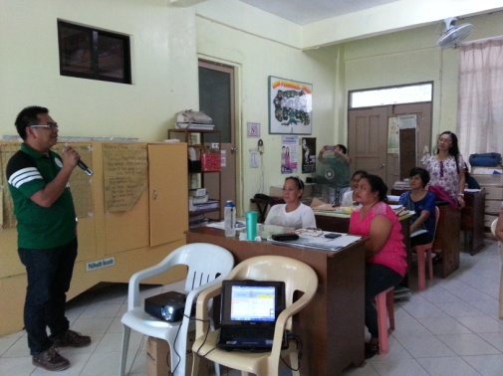
Quote from the Mayor
“Talagang gusto rin naming maging maayos ang proseso ng pagkolekta ng tamang impormasyon sa health … makakatulong nga yan para tama ang maging basihan namin ng pagbigay ng health services” (“We truly wanted that the process of collecting [health] information is instituted in our LGU… That will really help us establish a reliable basis for health service provision.”) – Mayor Eduardo R. Tibay, Mayor of the Municipality of Siniloan.

Slide 12
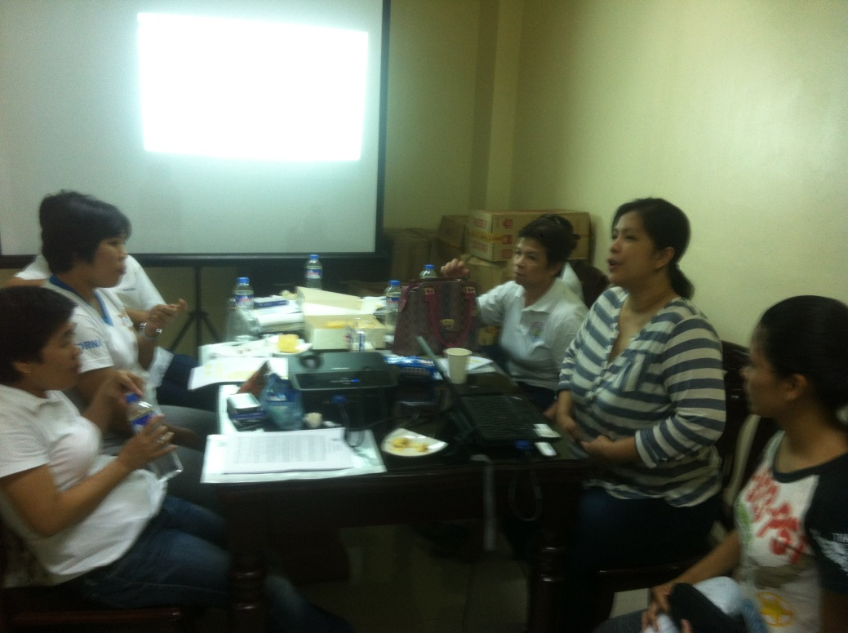
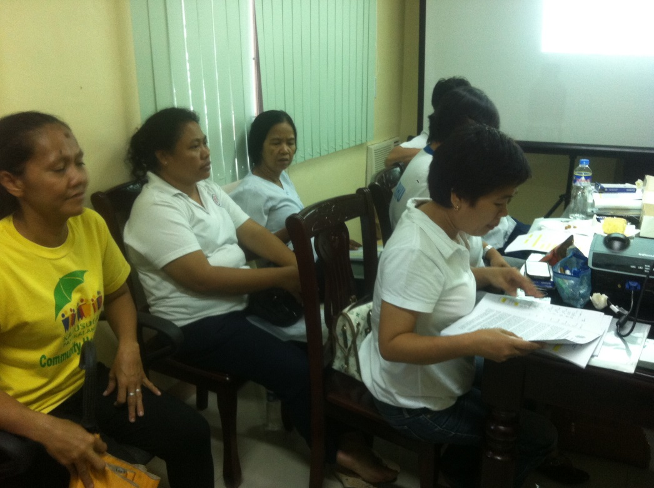
Quote from Midwives
“Mas komportable po kami at confident dahil mas tama na ang data na hawak namin at alam namin kung sino ang dapat na i-follow-up” - Nolita R. Recio & other Midwives of Siniloan Laguna
Notes:
For the case of Siniloan (Source: Dr. Girany Farinas, MHO Siniloan):
Additional FP clients (followed up; encouraged as new acceptors): 97
Additional mothers followed up to ensure compliance to required antigen for fully immunization (FIC): 49
Additional mothers coached and followed-up to continue exclusive breastfeeding: 28
Additional mothers followed-up for prenatal care to ensure compliance to “1-1-2” rule: 14

Slide 13
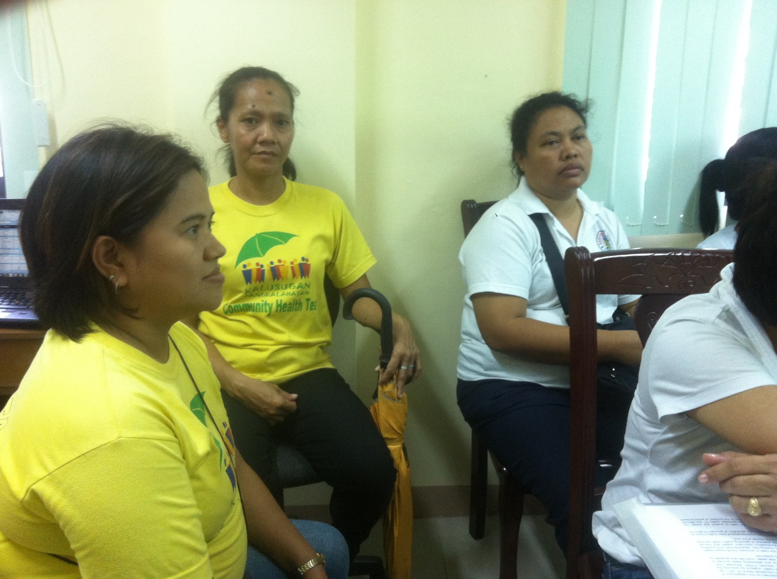
Quote from Clients/Beneficiaries
“Ay malaking bagay po talaga na ako ay napa-follow up ng midwife sa paggamit ng family planning. Kung hindi, baka ako ay buntis na naman”-
Nanay Rebie Baloran, FP Current User (IUD), handled by Midwife Mila

Slide 14
Thank you

